Slide 1

Chapter 9
Friendships and Romantic Relationships

Slide 2

Friendships
Romantic Relationships
Dimensions of Close Relationships
Styles of Loving
Sustaining Relationships

Slide 3
The Nature of Friendship
Friendship is a unique relationship that is voluntary, lacks institutionalized structure and guidelines, and does not require legal or religious guidelines

Slide 4
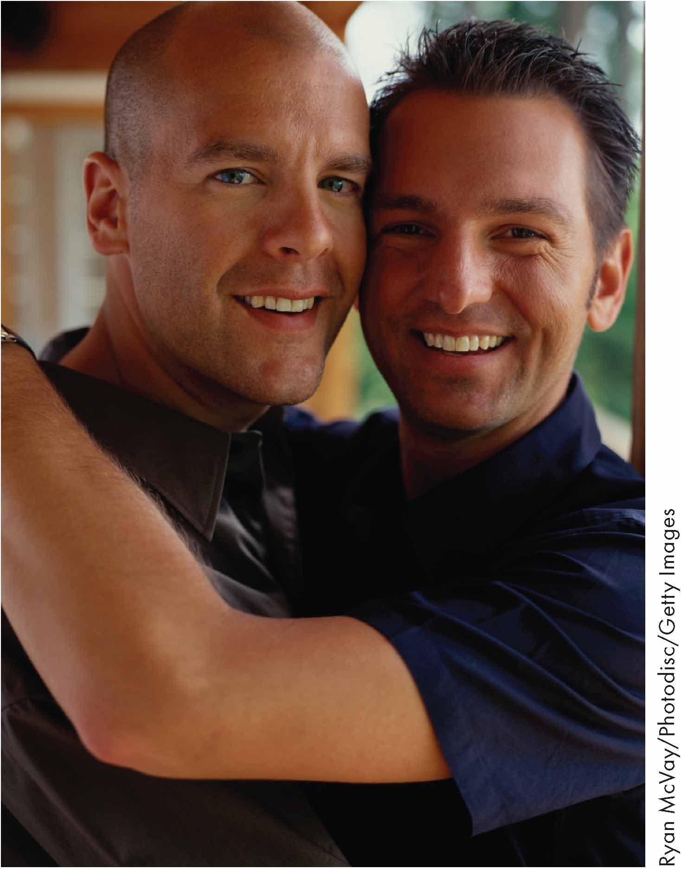
The Nature of Committed Romantic Relationships
Committed relationships are voluntary and exist between unique individuals who cannot be replaced; they involve romantic and sexual feelings

Slide 5

Dimensions of Close Relationships
Willingness to Invest
Emotional Closeness
Closeness through dialogue
Closeness through doing
Acceptance
Trust
Support
Passion
Commitment
Navigating

Slide 6
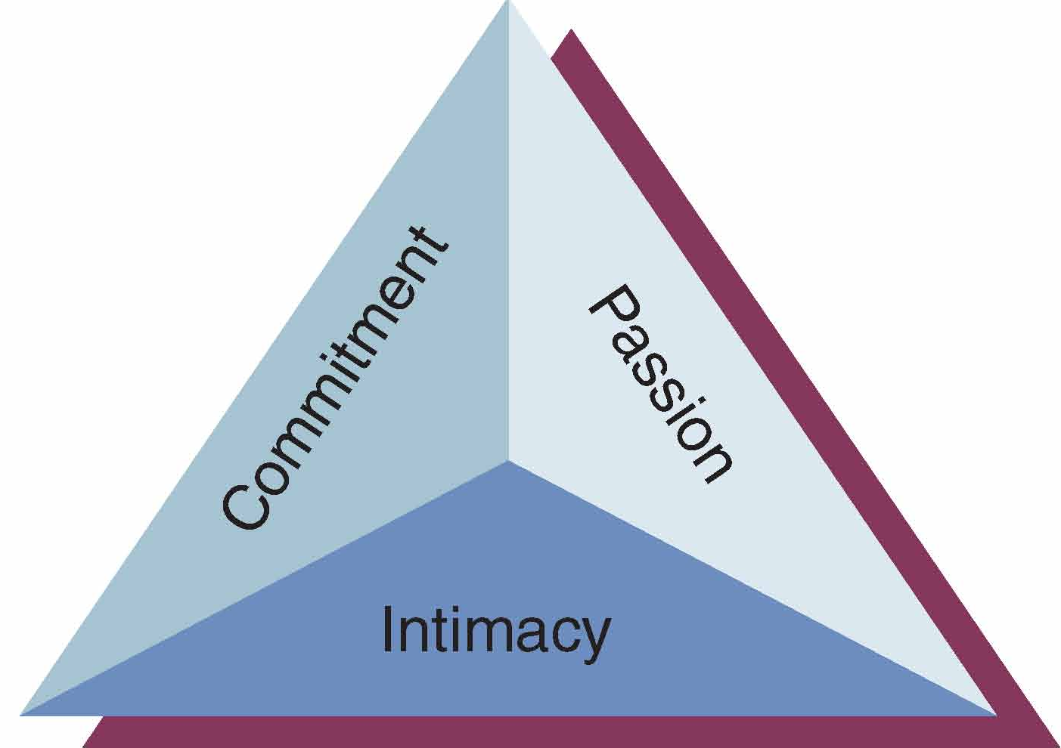
The Triangle of Love

Slide 7
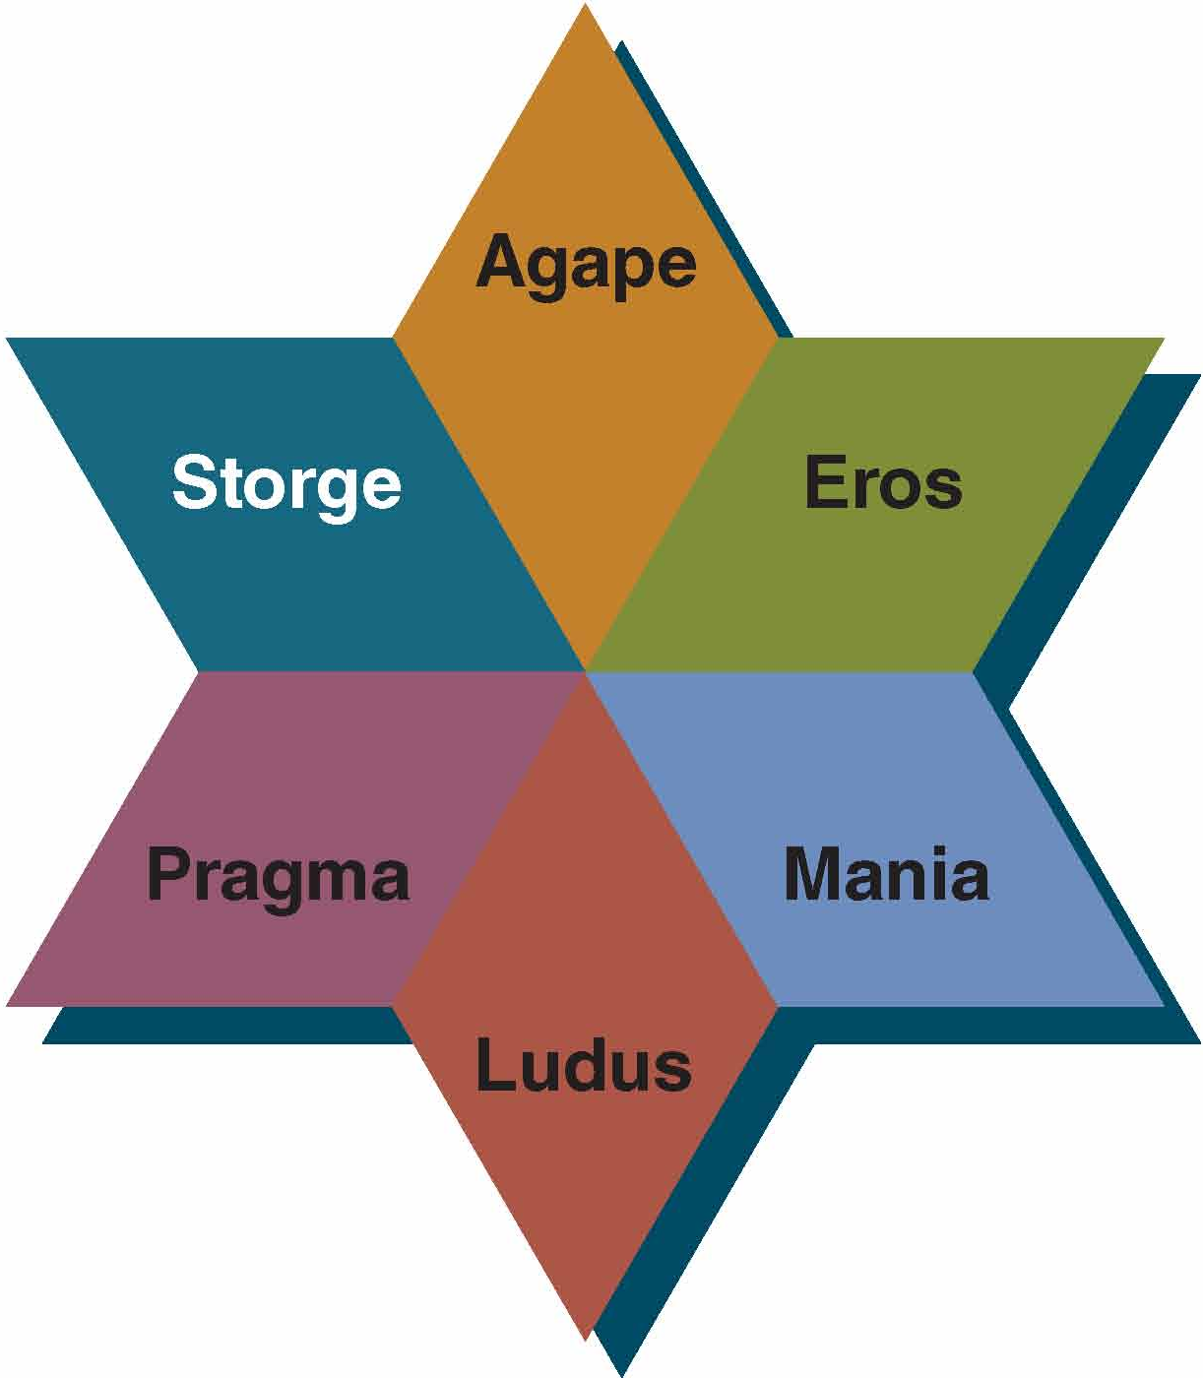
The Styles of Loving

Slide 8
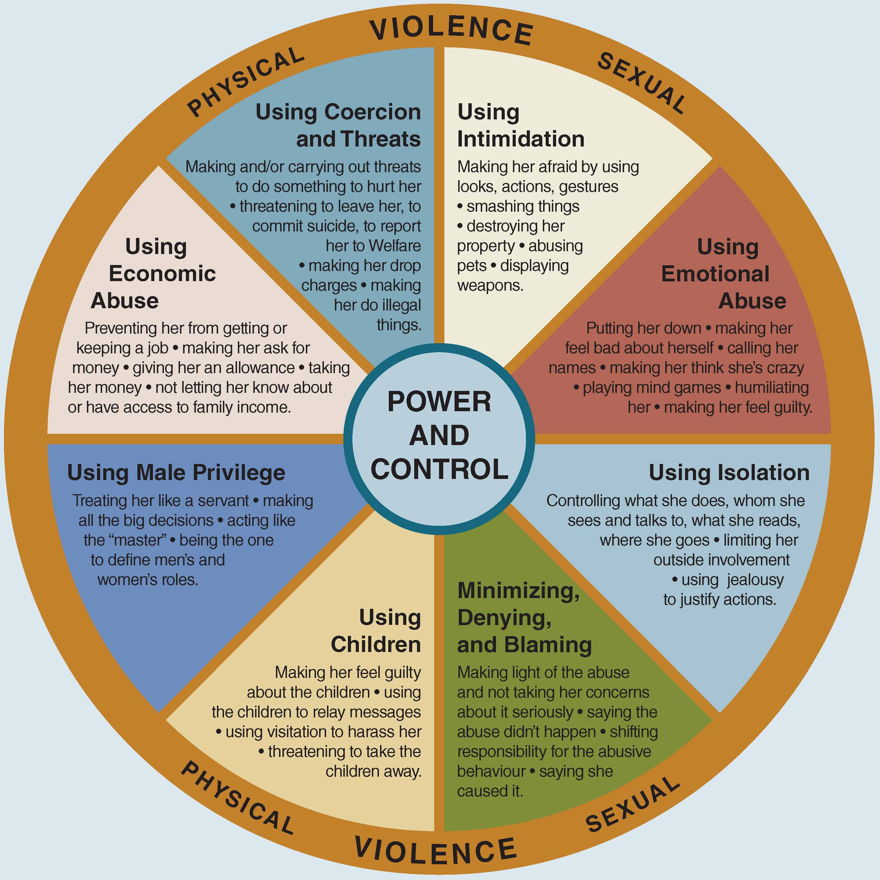
Power-based and Control-based Abuse

Slide 9
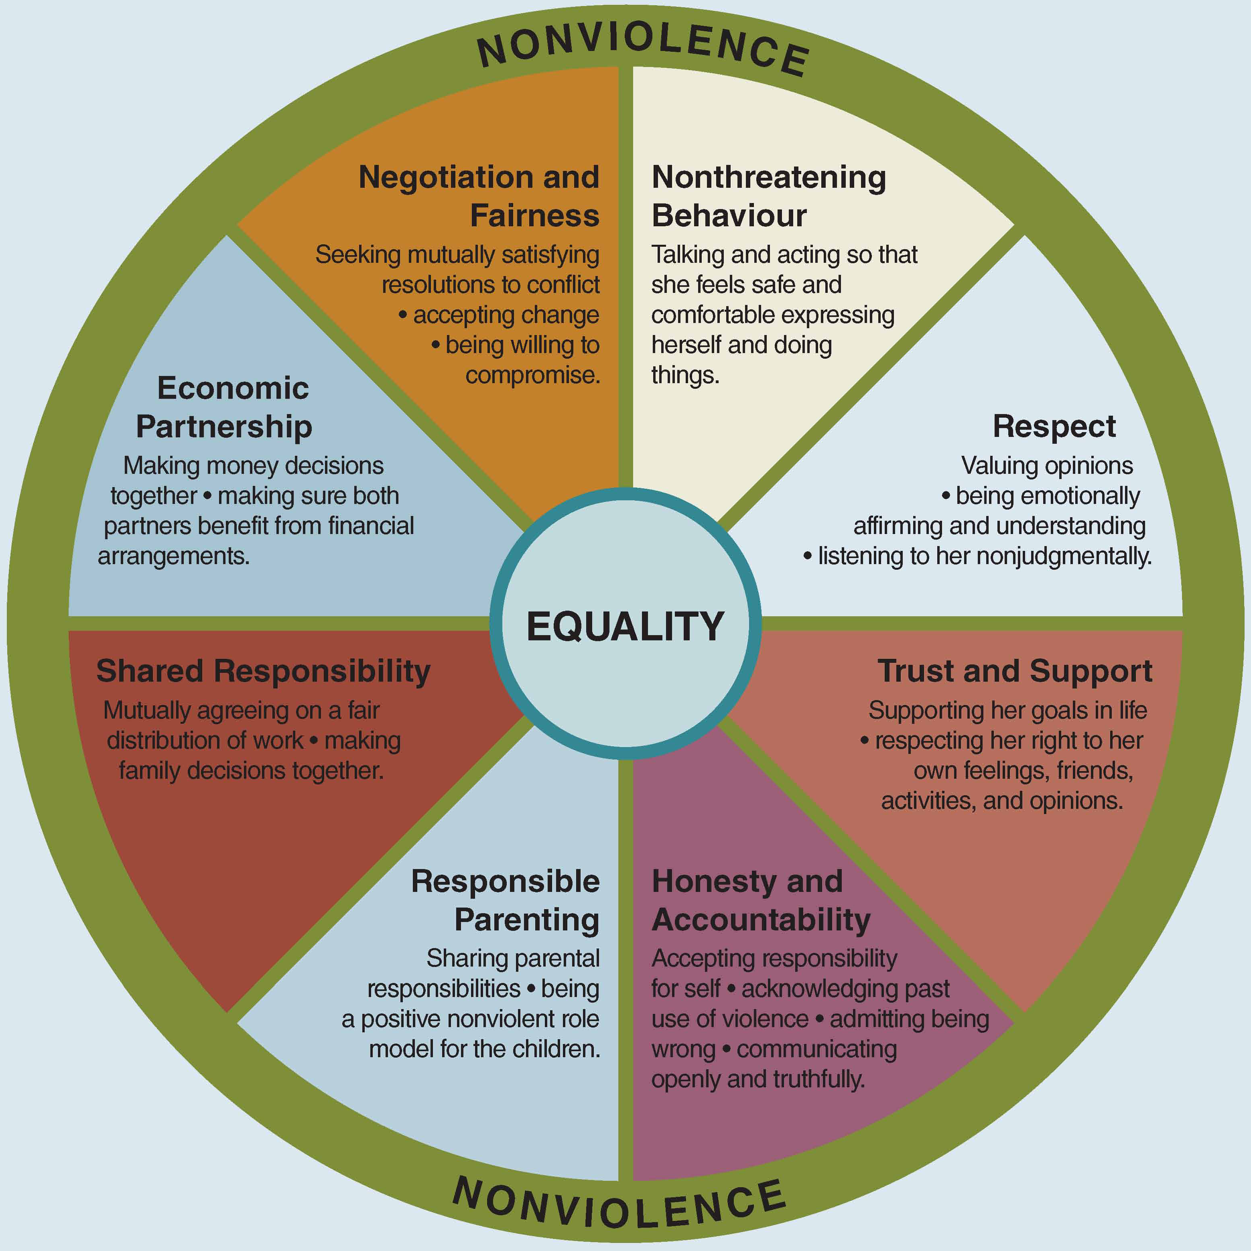
Equitable Relationship Interactions

Slide 10
Challenges to Sustaining Close Relationships
Internal Tensions
Relational dialectics
Diverse communication styles
Managing sex
Avoiding violence and abuse
External Pressures
Competing demands
Personal changes
Surviving distance
Ensuring equity

Slide 11

Guidelines for Sustaining Close Relationships
Engage in Dual Perspective
Communicate Honestly
Grow from Differences
Show Respect and Consideration
Make Daily Choices that Enhance Closeness and Intimacy
Don’t Sweat the Small Stuff

Slide 12
Summary
Friendships
Sustaining Relationships
Romantic Relationships
Chapter 9
Equity
Dimensions
Power in Relationships
Styles of Loving

